Slide 1
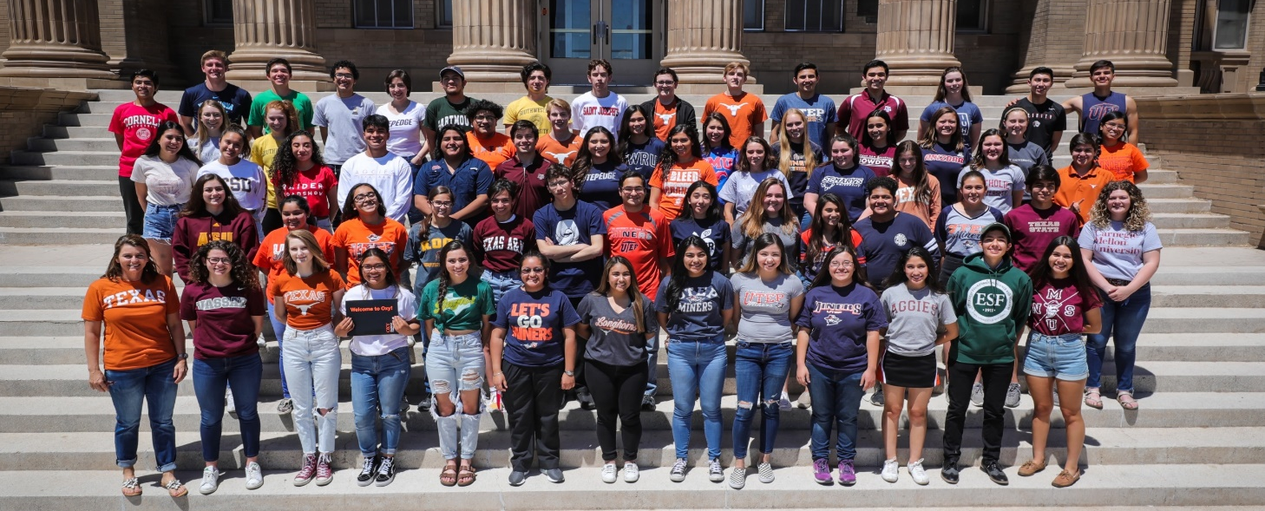
Freshman and Sophomore HIGH SCHOOL/COLLEGE PLANNING
Notes:
Add image of students w college shirts – ask Ceci P for one

Slide 2
The Texas Education Agency requires 26 credits for graduation:
Subject​ | No. of Credits Required​
English​ | 4​
Math​ | 4​
Science​ | 4​
Social Studies​ | 3​
Foreign Language​ | 2​
Physical Educations​ | 1​
Fine Arts​ | 1​
Technology​ | 1​
Speech​ | .5​
Health​ | .5​
Endorsements and Electives​ | 4.5 +​
High school credits can earned in middle school:
1.0: Algebra 1​
1.0: Foreign Language Year 1​
1.0: Foreign Language Year 2​
1.0 Technology*​
0.5: P. E.​
0.5 Speech*​
= 1.0 - 5.0 additional High School credits​
​
*Elective only/does not meet graduation requirement
El Paso High is on BLOCKED SCHEDULING​
Students can graduate with 32 credits or more​
The 6+ credits are elective choices used for:​
Required magnet programs courses​
Endorsement requirements​
Major Sports​
More than 1 Yr. Fine Arts​
CCTE Program Courses

Slide 3
Dual Language, T-STEM, APCapstone TEA HB5 Endorsements and Performance Acknowledgements
Each Endorsement has specific criteria and each endorsement appears on the final transcript​
Performance Acknowledgements appear on a student’s final official transcript
5 Endorsements:
Arts and Humanities Business Business or Industry Certification
Multidisciplinary
Public Service
STEM
5 Performance Acknowledgements
Bilingualism and Biliteracy
College Readiness
Dual Credit
IB (Not offered at EPHS)

Slide 4
Magnet programS Expectations Dual Language T-STEM AP Capstone
12 DL Courses
Foreign Language
Rigor: PAP, AP, DC, DE
80% Overall GPA
Pathway Selection
T-STEM Electives
PAP, DC, DE Rigor
2+ Summer Bridge Programs
Mentor Program
AP Research
AP Seminar
4 add’l AP Courses
4 AP Scores, 3 or higher
*STEM Classes can be On-level Courses

Slide 5
El Paso High School T-STEM
Biomedical
Biotech 1 & 2
Psychology
OnRamps Physics
OnRamps Chemistry
PAP Anatomy & Physiology
AP Biology
Mathematics
AP Statistics
Pre-Calculus
Calculus AB
Calculus BC
Physics 2
Physics C
Robotics
Princ. Appl. Engineering DL STEM
Robotics 1
Robotics 2
OnRamps Physics
OnRamps Computer Science DL STEM
OnRamps Physics
Environmental Science
Computer Science
Fundamentals of Comp Sci STEM
OnRamps Computer Science DL STEM
PAP Computer Science DL STEM
AP Computer Science DL STEM
AP Statistics
Calculus AB
Calculus BC
CCTE 2 Year Programs can be taken grade 11 and 12
Licenses:
Microsoft, Adobe, drone flyer
Certifications
EMT, LVN
https://www.episd.org/ccte
*STEM Classes can be On-level Courses

Slide 6
El Paso High School Magnet
Nationally recognized program
Classes taught 50% in Spanish and 50% English
Program is skill specific and not career specific
Translation class only offered at EPHS
Earn UMC medical interpretation certificate
Earn multiple HB 5 Endorsements

Slide 7
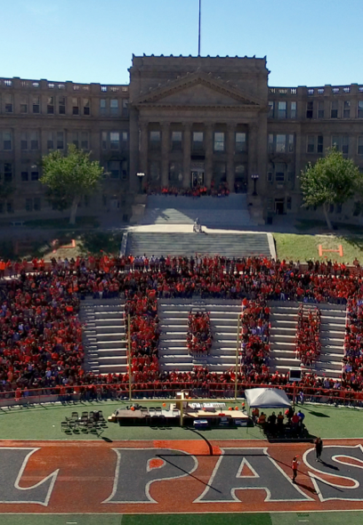
2 - Year upper level program
Offered only at EPHS
Can be combined with Dual Language Magnet or T-STEM Academy
Earn an AP C
Earn an AP Capstone Diploma

Slide 8
Endorsements & HB5
This is your Graduation Plan of Study and should match your future goals.

Slide 9
Advanced Classes offered at EPHS
Math Alg 2 OnRamps Pre-Calc. DC Pre-Calc. OnRamps AP Cal. AB AP Cal BC AP Statistics AP Computer Science OnRamps Computer Science | English AP Eng. Lang. AP Eng. Lit English 3 On Ramps AP Seminar AP Research AP English 3 AP English 4 | Social Studies AP Human Geo. AP World History AP US History DC US History AP Government AP Economics AP Psychology | Science AP Biology OnRampsChemistry OnRamps Physics 1 AP Physics 2 AP Physics C AP Envir. Science OnRamps Geology | Other AP Spanish Language AP Spanish Literature AP Art DC Communication

Slide 10
What does AP mean? PAP? Dual Credit? OnRamps?
(PAP) Pre Advanced Placement-Supports students who are interested in taking advanced courses
(AP) – Advanced Placement
Follows standards set by College Board
SAT/ PSAT/ AP falls under College Board
College credit may earned by passing AP exam with a 3,4,or 5
2 major premises set by College Board
Expectation-students can perform well at rigorous academic levels
Opportunity to engage in a higher level of learning and critical thinking.
(DC) Dual Credit-
College Courses at EPHS through El Paso Community College
Grade posts to college and high school transcript
OnRamps- University of Texas at Austin Courses at EPHS
Provides students with opportunity to take UT courses structured by a UT professor with support from EPHS Students
Students can choose to take the College credit.

Slide 11
College Admissions Timeline
9th Grade Fall
Create a four-year high school plan taking into consideration student goals and ambitions.
Look at college admission requirements for ideal colleges. It’s never early to plan.
Begin discussing future career options.
Get involved in extra curricular activities – have a balance (one athletic, one academic.)
9th Grade Spring Semester
Meet with school counselor to discuss 10th grade course options.
Adjust four-year high school plan as needed to reflect change in goals.
Maintain involvement in extra-curricular activities.
Prepare for End of Course Exam(s). (This is required for graduation.)
Begin Academic Resume
**Remember that if your child graduates in the top 10% they have automatic admission to any TEXAS PUBLIC SCHOOL (UT Austin is the exception)
Ex: Texas A&M
SAT: Reading 580-680
Math 590-700
GPA: 3.5-4.0
www.thoughtco.com- Provides information on Texas Public School Admissions

Slide 12
College Admissions Timeline
10th Grade Fall Semester
Modify four-year plan to reflect new goals.
Ensure you are taking rigorous classes to prepare a strong academic resume for college admissions.
Take PSAT seriously in order to begin preparing for Junior PSAT and ACT/SAT.
Continue involvement in extracurricular activities and begin taking leadership roles.
10th Grade Spring Semester
Meet with counselor to begin planning rigorous junior year curriculum.
Consider CCTE courses as an option for electives.
Attend college and career fairs to begin exploring college admissions requirements.
Tour college campuses as apart of family travel.
Run for leadership positions with clubs and organizations.
Update your Academic Resume

Slide 13
Resources
Test Prep:
Khan Academy
College Board
Kaptest
Scholarships:
Raise Me
College Board
College Websites that help:
Big Future
www.bigfuture.com
College for All Texans
www.collegeforalltexans.com
Visit EPHS College Website:
ephscollegeweebly.com

Slide 14
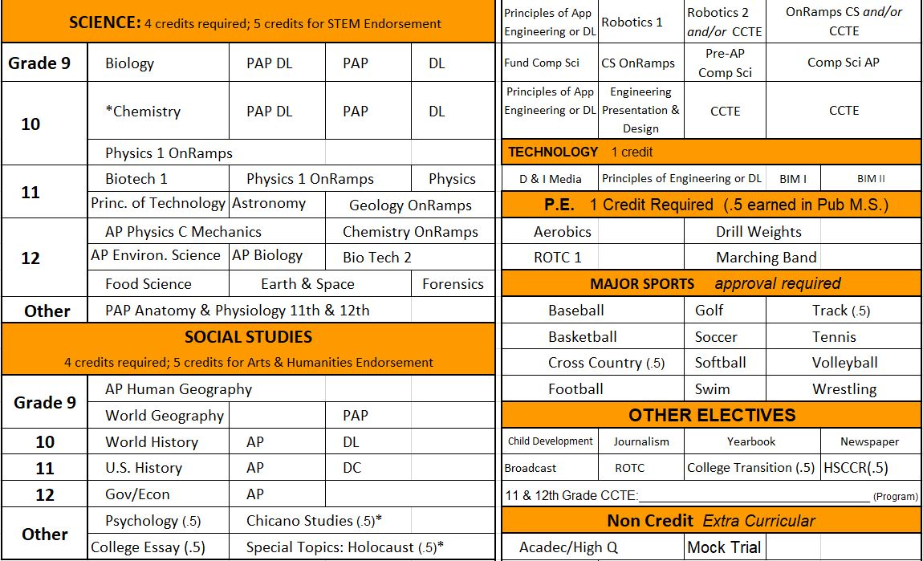
Pre-Registration
Students are meeting with counselors through English courses.
Please review and sign the card.
Students must return signed copy to English teacher or counselor.

Slide 15
IMPORTANT !
Remember to support your student every day.
Create mindful habits for studying.
Teach accountability for managing academics and extracurricular activities.
Teach communication and advocacy.
Create opportunities for reflection and perseverance.
Encourage your student daily.
Remember that “failures” are only losses when they are not used as an opportunity to grow.
A Straight “A” grade is not everything.
Develop habits for self-monitoring and parent-student monitoring of academic progress.
Remember that school is an opportunity for learning and growth in more areas than just academics.
Be mindful of the “whole” student/self.
Make opportunity for outside involvement: community service, clubs, fine arts, etc.

Slide 16
Academic and Counseling Center
Mrs. Simpson, College Readiness Coordinator
casimpso@episd.org
Andrea Luevano, School Counselor A-D
adluevan@episd.org
Karla Tejeda, School Counselor E-K,
kmtejeda@episd.org
Cristina Rosales, School Counselor L-P,
crosale1@episd.org
Cecilia Espinosa, School Counselor Q-Z
ceaguil1@episd.org
Cecilia Phillips, Magnet Programs Coordinator
cyphilli@episd.org
Notes:
Add websites

